Slide 1

CP301 MEDICAL IMAGE CLASSIFICATION: PNEUMONIA

Slide 2
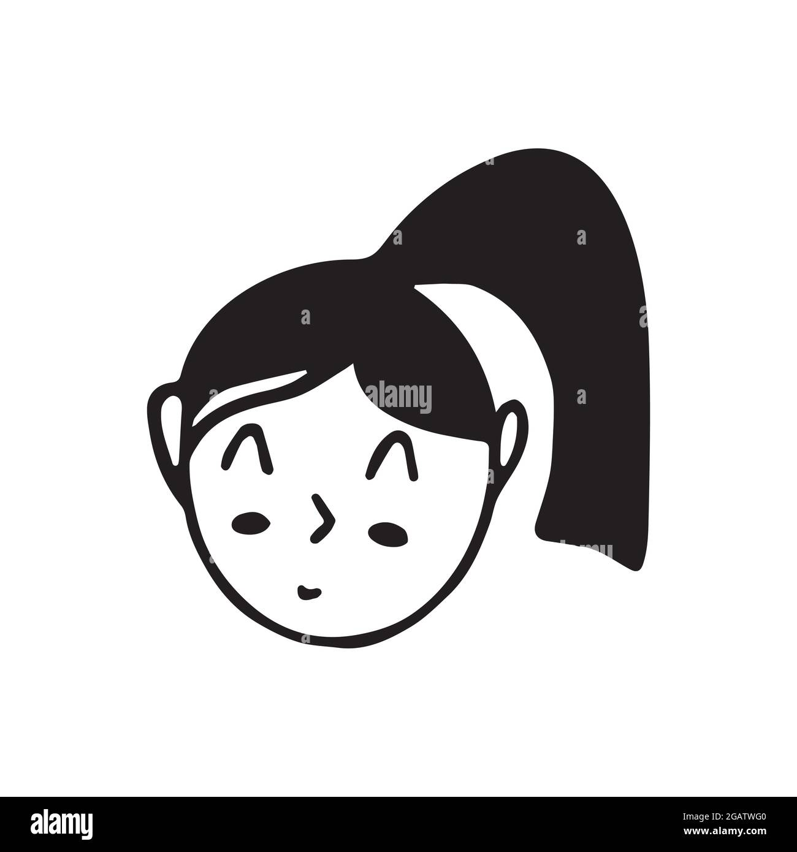



TEAM PRESENTATION
Kirti Singh 2019EEB1166
Nakul Ranjan 2019EEB1175
Shreya Gupta 2019EEB1196
Routhu Rohith Kumar 2019EEB1187

Slide 3
ABOUT MEDICAL IMAGE CLASSIFICATION
Medical Image provides information about the spatially resolved information of a human body.
Classification of such images to identify the abnormality is Medical Image Classification.
In this project, the work is done around classification of Lung X-Rays to classify the pneumonia.
Notes:
Medical Image
Abnormality
Lung X-Rays

Slide 4
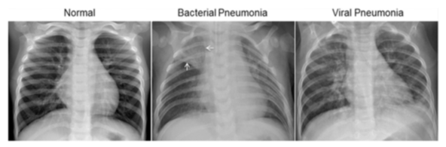
PNEUMONIA CLASSIFICATION

Slide 5
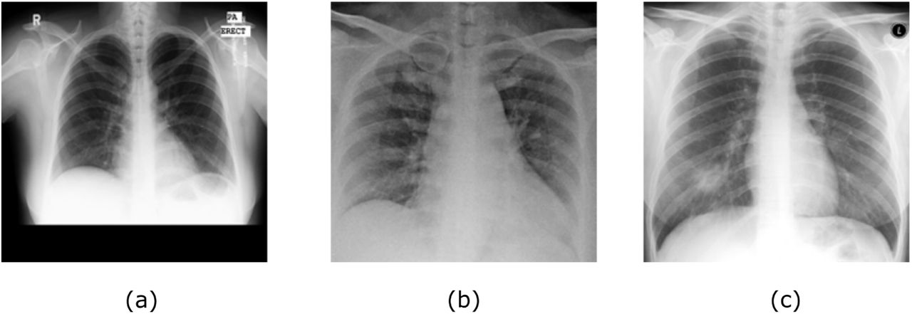
IMAGE PREPROCESSING
A typical dataset with various X-Ray image are of different dimensions and contrast scale and hence they are preprocessed to get similar dimensions and normalised pixel brightness on the greyscale.

Slide 6
STEPS FOR PNEUMONIA CLASSIFICATION
PREPROCESSING
TRAINING
TESTING
Data preprocessing is a process of preparing the raw data and making it suitable for a machine learning model.
A machine learning training model is a process in which a machine learning (ML) algorithm is fed with sufficient training data to learn from.
In machine learning, model testing is referred to as the process where the performance of a fully trained model is evaluated on a testing set.
1
2
3

Slide 7
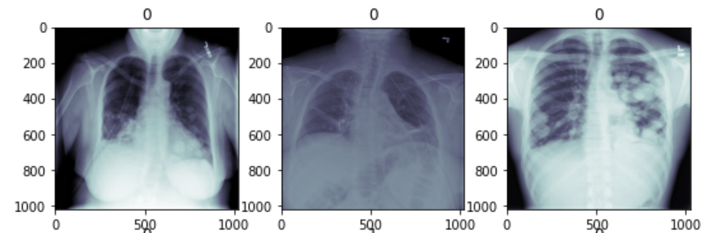
PREPROCESSING
The images in the dataset are of the size 1024 x 1024 and without standardized pixel values.

Slide 8
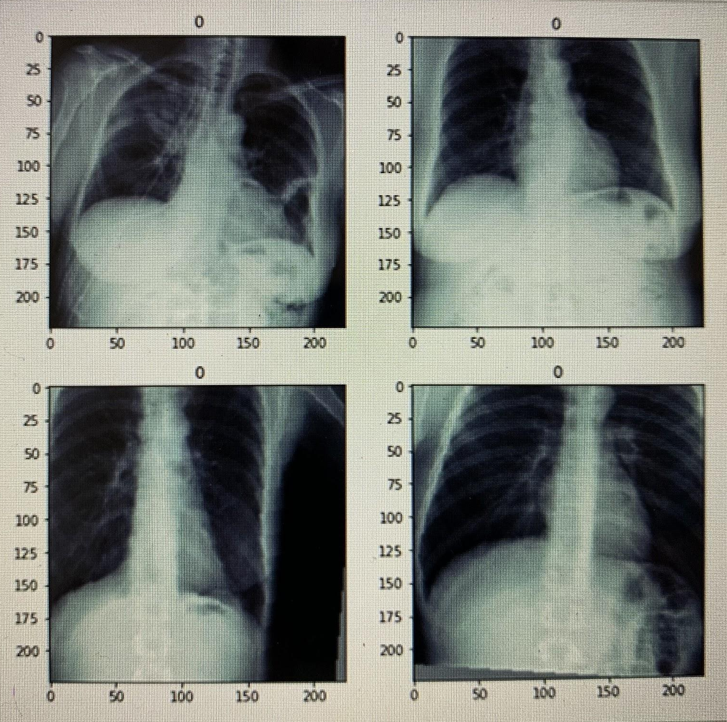
PREPROCESSING
The preprocessing was done in a fashion to reduce the size of images to 224 x 224. Also the the pixel value was standardized pixel values into the interval [0,1] by scaling with 1/255.

Slide 9
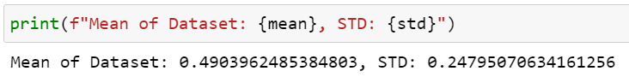
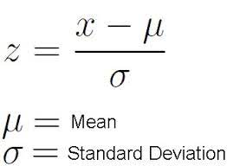
PREPROCESSING
Compute training mean and standard deviation of all the pixel values for further normalisation.

Slide 10
TRAIN-TEST SPLIT
Once, the dataset was preprocessed, the task was to train the data.
Hence, the train-test split was done to obtain training data and validation data. TRAIN IMAGES - 24000 VALIDATION IMAGES - 2684

Slide 11
TRAINING
OPTIMIZERS
03
LAYERS
01
02
LOSS FUNCTION

Slide 12
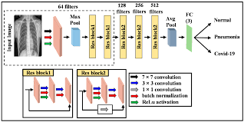
TRAINING: ADDITION OF LAYERS
The ResNet 18 network architecture is used in the addition of layers.
WHAT IS ResNet 18? ResNet-18 is a convolutional neural network that is 18 layers deep. You can load a pre-trained version of the network trained on more than a million images from the ImageNet database.

Slide 13
TRAINING: ADDITION OF LAYERS
As most of the torchvision models, the original ResNet expects a three channel input in conv1.
However, our X-Ray image data has only one channel. Thus we need to change the in_channel parameter from 3 to 1.
Additionally, we will change the last fully connected layer to have only one output as we have a binary class label.

Slide 14
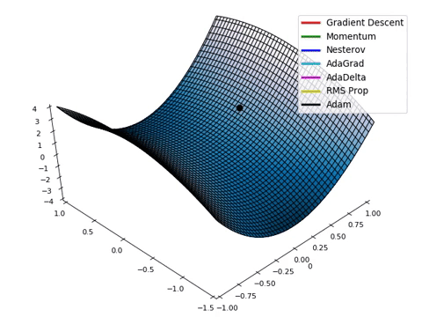
TRAINING: ADDING OPTIMIZERS
An optimizer is a function or an algorithm that modifies the attributes of the neural network, such as weights and learning rate. Thus, it helps in reducing the overall loss and improve the accuracy.
In this model, we have used ADAM optimizer for better accuracy of the model. ADAM uses momentum and Adaptive learning rates and hence converges faster.
Notes:
While training the deep learning model, we need to modify each epoch's weights and minimize the loss function.

Slide 15
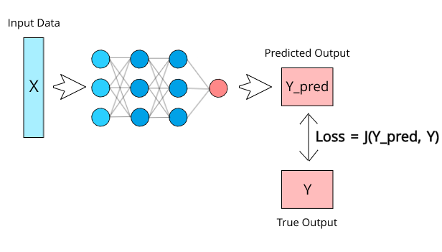
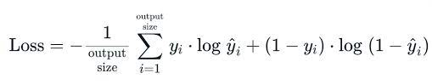
TRAINING: ADDING LOSS FUNCTION
The loss function used in the model is Binary Cross Entropy loss function.
In fact we use BCE With Logits Loss which directly accepts the raw unprocessed predicted values and computes the sigmoid activation function before applying Cross Entropy).

Slide 16
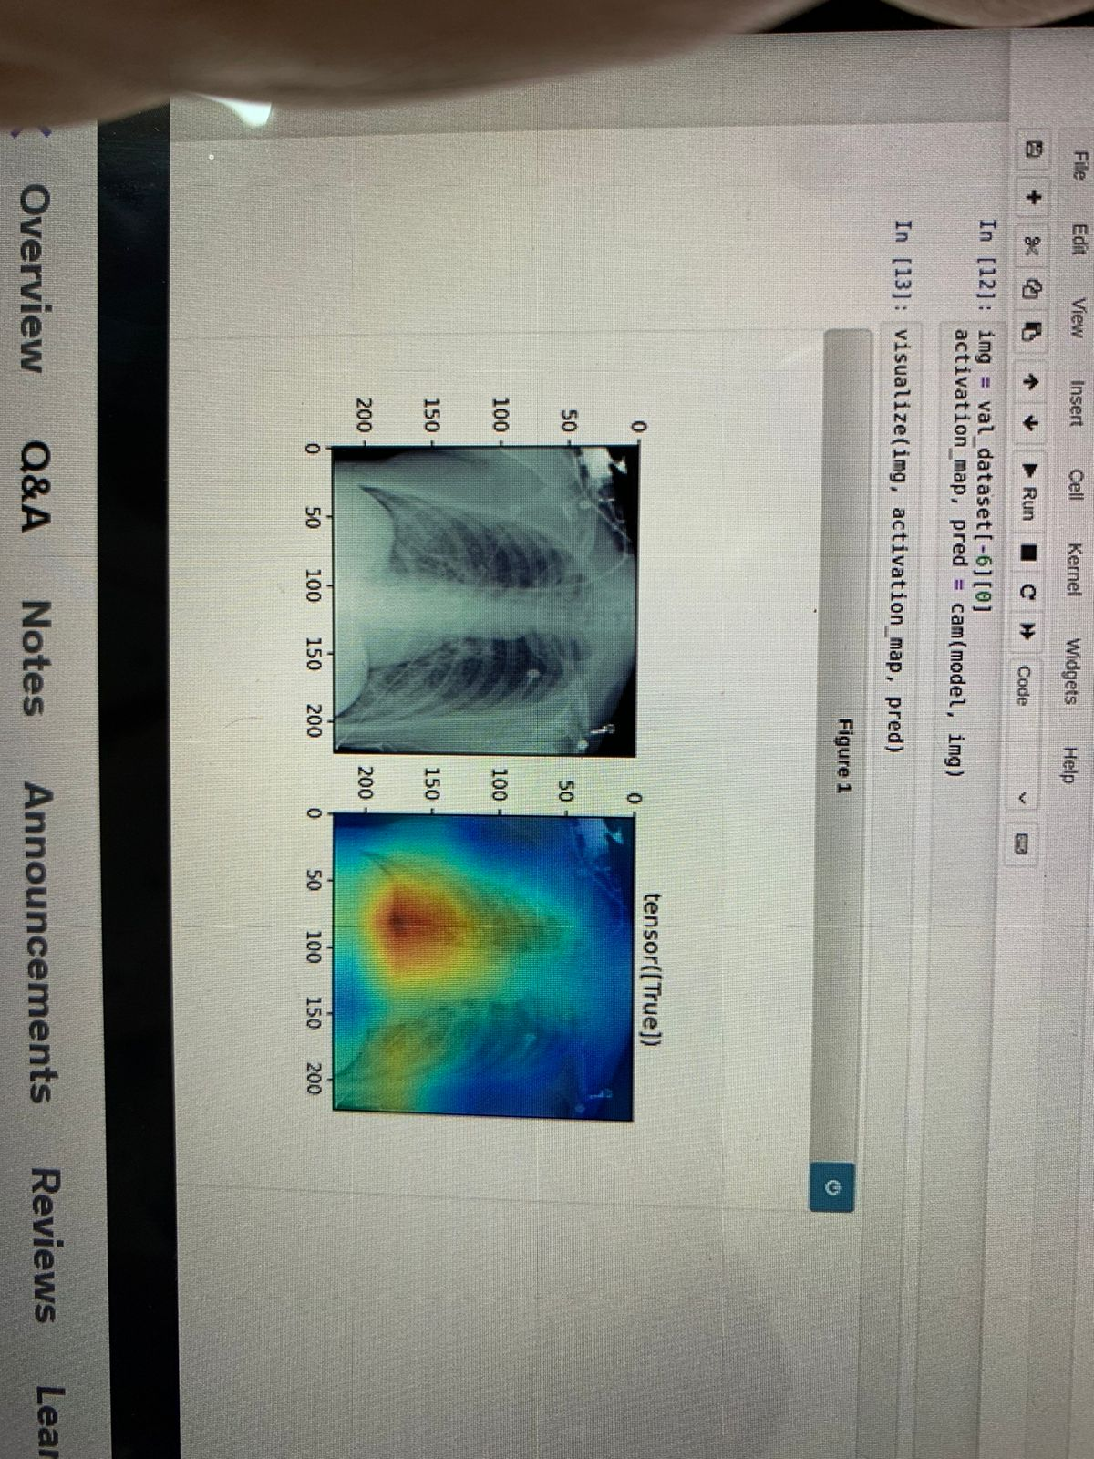
INTERPRETABILITY
We make use of Class Activation Maps (CAM)
It is a method to visualize image regions most important for the decision of the classifier.

Slide 17
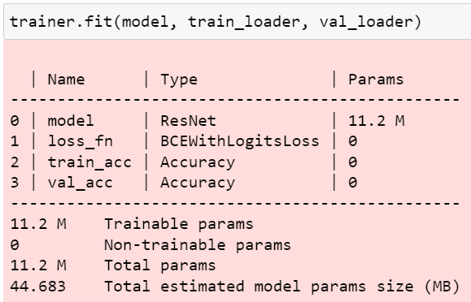
TRAINING SUMMARY

Slide 18
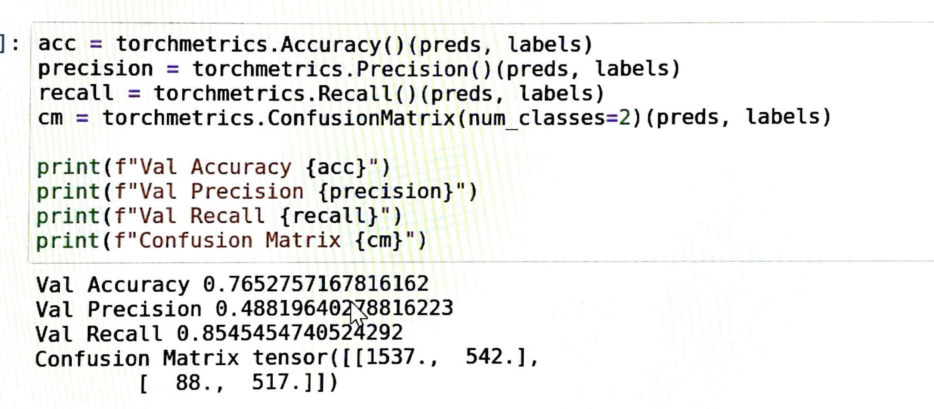
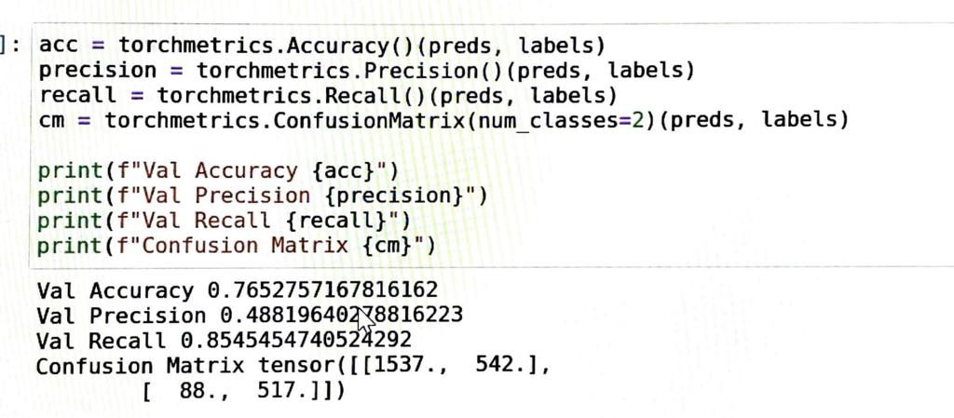
TESTING
The overall result is calculated using the torchmetrics library.
Accuracy, Precision, Recall and Confusion matrix were computed.

Slide 19
TESTING
Recall is much larger than the precision.
Recall tells us that the model rarely misses a case of pneumonia.
Low precision means that many images without pneumonia are also classified as pneumonic.

Slide 20
76.5276%
48.8196%
85.4545%
Accuracy
Precision
Recall

Slide 21
CONCLUSION
The overall result is decent with our model.
There are a large number of False Negatives due to the data imbalance.
Training the model on a large dataset will lead to a more accurate model which will require a larger GPU, and much greater processing times, which is out of scope at the present level.

